Slide 1


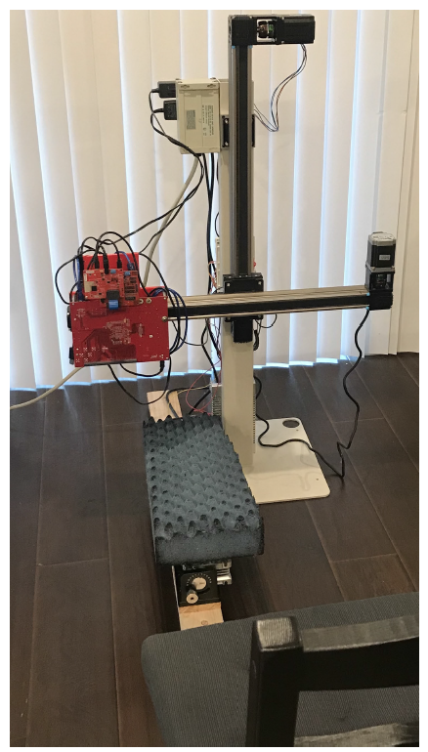
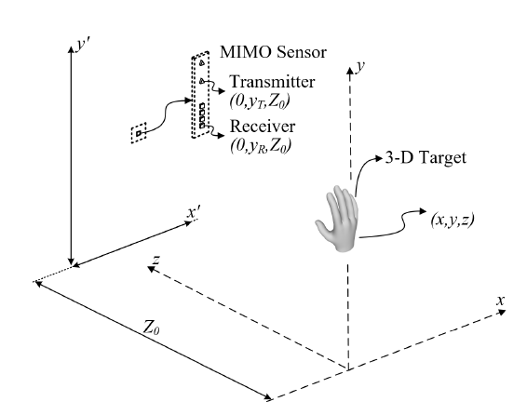
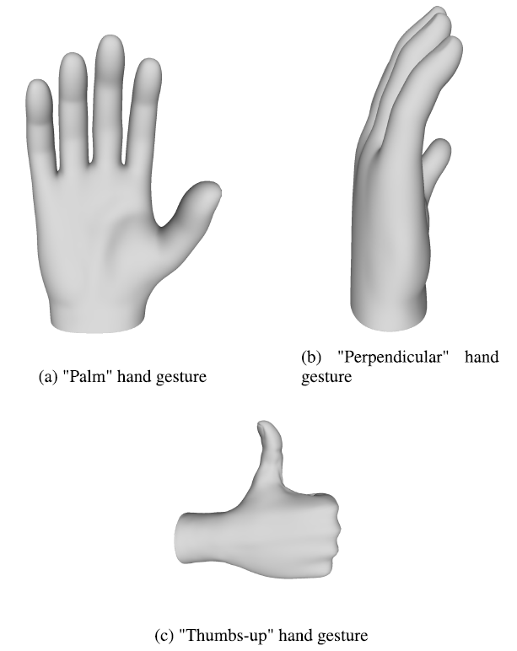
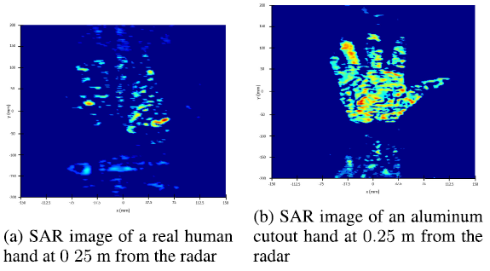
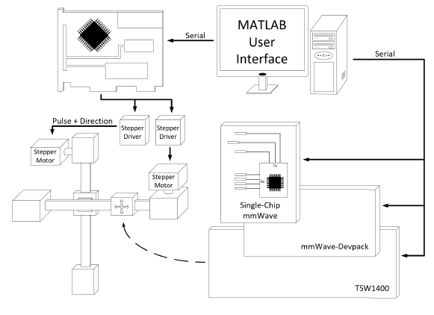
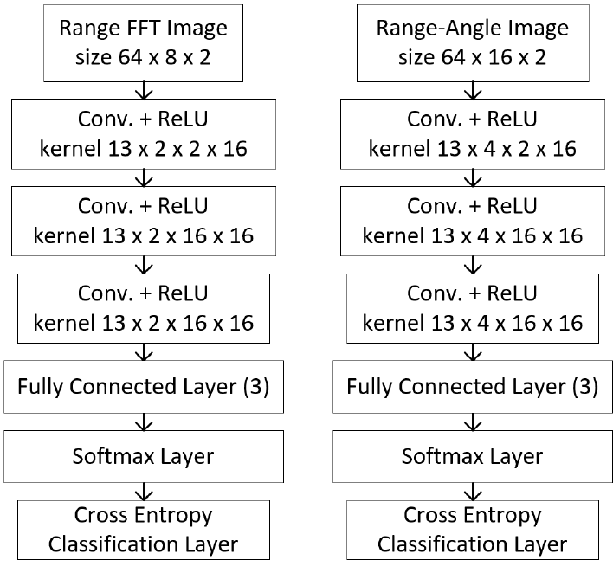
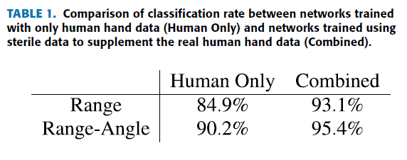
Improved Static Hand Gesture Classification on Deep Convolutional Neural Networks Using Novel Sterile Training Technique
J. Smith, S. Thiagarajan, R. Willis, Y. Makris, M. Torlak
The University of Texas at Dallas, 800 W. Campbell Rd. Richardson, TX 75080
Motivation
Background
mmWave radar devices have emerged as a promising alternative offering low-cost system-on-chip sensors containing precise spatial information making radar imaging promising alternative to optical cameras introducing aluminum cutout (sterile) images used for static hand gesture classification
Aluminum cutout demonstrates high radar cross-section (RCS) resulting in a high signal-to-noise-ratio (SNR)
Multistatic-to-monostatic conversion ease the signal processing to approximate this multistatic echo signal to a monostatic version.
Hand gesture recognition is an integral part of wireless human-computer-interaction (HCI). FMCW mmWave radar are advantageous over optical solutions, due to the semi-penetrative nature of the electromagnetic (EM) at the wavelengths.
Three static hand gestures were collected for training and validation
Problem Statement
Data collection approach using novel sterile technique able to resolve and enhance human hand reflectivity and features prominence improving classification accuracy of non-moving (static) hand gestures using convolutional neural network (CNN) and frequency modulated continuous wave (FMCW) milimeter wave (mmWave) radars.
Proposed Solution
Sample human hand gestures within the scanning range of 0.25 m and 0.25 m from the radar and to a square with sides of 0.25 m.
Perform the gesture with the hand kept away from the torso to avoid occluding the hand in the torso peak’s side-lobes.
Collect dataset from many perspectives using 2D mechanical scanner from both “real” human hands and sterile aluminum cutouts.
Apply a synthetic radar aperture (SAR) approach to reconstruct an image of the human hand with and without aluminum cutout.
Preprocess complex-valued data by applying multistatic-to-monostatic conversion along with either range or range-angle FFTs.
Develop CNN architectures keeping in mind that inputs normalization may ruin the phase interdependence.
Train CNN architectures by using dataset with both real and sterile images.
Results
Summary
Description
Description
Datasets used to train the CNN architectures are based on the preprocessing applying algorithm (Range or Range-Angle) and the existence of the sterile data in it.
To ensure consistency 8000 samples used for validation dataset and reused for each experiment.
Prediction accuracy of the dataset with sterile aluminum cutouts has been improved for both range and range-angle algorithms to 93.1% and 95.4%, respectively.
Novel data collection and training techniques applied to improve the classification of static hand gestures using mmWave FMCW radar and convolutional neural networks.
Two-dimensional mechanical scanner allows the collection of large, diverse radar datasets.
Aluminum sterile cutouts aid to improve classification accuracy.
Future Work
Increase number of gestures, degrees of freedom, to create a more robust classifier
Many applications can benefit from training on sterile data to improve classification accuracy.
Publications
Acknowledgments
[1] J. W. Smith, S. Thiagarajan, R. Willis, Y. Makris and M. Torlak, “Improved Static Hand Gesture Classification on Deep Convolutional Neural Networks Using Novel Sterile Training Technique,” in IEEE Access, vol. 9, pp. 10893-10902, 2021.
This work is supported by Texas Instruments through Foundational Technology Research Centre (FTRC).

